Slide 1
Distribution management system
A distribution management system (DMS) is a collection of applications designed to monitor and control the electrical power distribution networks efficiently and reliably.
It acts as a decision support system to assist the control room and field operating personnel with the monitoring and control of the electric distribution system.
Improving the reliability and quality of service in terms of reducing outages, minimizing outage time, maintaining acceptable frequency and voltages levels are the key deliverables of a DMS

Slide 2
Distribution management system
The ultimate goal of a DMS is to enable a smart, self-healing distribution system and to provide improvements in: supply reliability and quality, efficiency and effectiveness of system operation
The first generation of Distribution Management Systems integrated a number of simple Applications into a computer system.
An interactive graphical user interface was then added to visualise the network being managed.
As more and more Applications were added, managing the information exchange and maintaining the DMS became a challenge
Standardized models such as the Common Information Model (CIM) were developed to aid information management

Slide 3
WHY DMS
Reduce the duration of outages
Improve the speed and accuracy of outage predictions.
Reduce crew patrol and drive times through improved outage locating.
Improve the operational efficiency
Determine the crew resources necessary to achieve restoration objectives.
Effectively utilize resources between operating regions.
Determine when best to schedule mutual aid crews.
Increased customer satisfaction
A DMS incorporates IVR and other mobile technologies, through which there is an improved outage communications for customer calls.
Provide customers with more accurate estimated restoration times.
Improve service reliability by tracking all customers affected by an outage, determining electrical configurations of every device on every feeder, and compiling details about each restoration process.

Slide 4
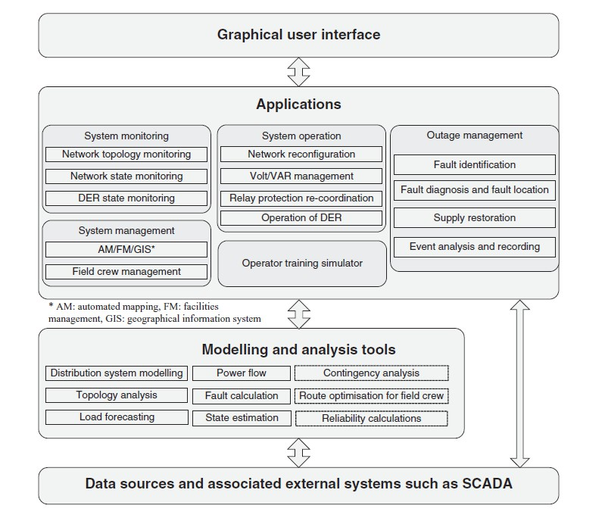
Structure and main components of a DMS

Slide 5
Distribution management system
Key Layers and Components:
Graphical User Interface (GUI): At the top layer, there's a GUI, which is how operators interact with the underlying system.
Applications Layer: This is the core of the system, divided into several specialized functional groups:
System monitoring: Includes modules for network topology, network state, and Distributed Energy Resources (DER) state monitoring.
System management: Comprises AM/FM/GIS (automated mapping, facilities management, geographical information system) and field crew management.
System operation: Involves network reconfiguration, Volt/VAR management, relay protection re-coordination, and operation of DER.
Outage management: Crucial for fault identification, diagnosis, location, supply restoration, and event analysis.
Operator training simulator: A dedicated tool for training system operators.

Slide 6
Distribution management system
Modelling and Analysis Tools: This layer provides the computational intelligence for the system. It includes tools for:
Distribution system modelling
Topology analysis
Load forecasting
Power flow and fault calculations
State estimation
Contingency analysis
Route optimization for field crews
Reliability calculations
Data Sources and External Systems: The foundational layer that feeds data into the system, such as SCADA (Supervisory Control and Data Acquisition) systems.

Slide 7
A DMS includes Applications:
for system monitoring, operation and outage management.The primary object of these Applications is maintaining continuity of supply.
to help manage the assets of the utility, such as inventory control, construction, plant records, drawings, and mapping. These include the automated mapping system, the facilities management system, and the geographical information system.
associated with design and planning for network extensions
All these Applications require modelling and analysis tools for which network parameters, customer information, and network status data are used as inputs.

Slide 8
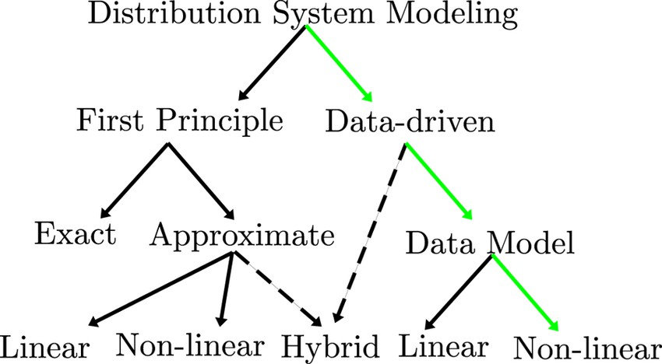
Distribution system modelling
The two main approaches are data‐driven and first principle modelling.
First principle (physical model)‐based approaches are currently dominant
Exact modelling :In this approach, the complete first principle model is used without any assumptions. As the size of the distribution system gets larger, developing an exact model from first principle becomes a difficult and labour‐intensive task.
Approximate modelling relaxes some of the non‐linearities of the models to decrease
the model computational burden and development time

Slide 9
The non‐linear approach includes approximations for simplification and is more
accurate over a larger operation space.
When fully linearised, the model becomes computationally efficient, yet the performance (accuracy) degrades
In pure data model approach only data is used for modelling. Both the structure and the parameters are learned from the data
Hybrid modelling uses a combination of both the first principle as well as data‐driven modelling.In this case, the first principle model provides some information about the structure, whereas some parameters are learned using data.

Slide 10
BASIC BLOCKS OF DMS

Slide 11

DMS Functions
Network visualization & support tools
Applications for Analytical & Remedial Action
Utility Planning Tools
System Protection Schemes

Slide 12
Structure of DMS
The structure of a Distribution Management System (DMS) in power grids typically consists of three main layers:
Field Layer: This layer includes all the physical devices and equipment in the distribution network, such as sensors, meters, switches, and transformers. These devices collect real-time data about the status of the network and communicate it to the upper layers of the DMS.
Control Layer: This layer includes the software applications that analyze and process the data collected from the field layer. The control layer is responsible for monitoring the network, detecting faults and outages, and managing power flows to ensure reliable and efficient service to customers. The control layer also includes tools for dispatching crews to repair faults and restore service.
Operation Layer: This layer includes the software applications that provide a graphical interface for utility operators to interact with the DMS. The operation layer displays real-time information about the status of the network, including the location of faults, the load on individual feeders, and the status of customer service requests. The operation layer also includes tools for generating reports and analyzing historical data to optimize the performance of the distribution network

Slide 13
Components of DMS
Supervisory Control and Data Acquisition (SCADA): It is a system that collects real-time data from sensors and remote devices located throughout the distribution network. The SCADA system is responsible for measuring voltage, current, frequency, and other parameters of the power system.
Distribution Automation System (DAS): It is a system that enables automatic control and monitoring of the distribution network. The DAS includes switches, relays, and other equipment that can be remotely controlled to isolate faulty sections of the network or redirect power flows.
Outage Management System (OMS): It is a system that helps utilities manage power outages by quickly identifying the location of the fault and dispatching crews to repair it. The OMS also provides real-time information about the status of the network to utility operators and customers.
Geographical Information System (GIS): It is a system that helps utilities visualize and manage the physical assets of the distribution network, such as transformers, feeders, and substations. The GIS also provides location-based information about the network, such as land use, zoning, and demographics.

Slide 14
Customer Information System (CIS): It is a system that helps utilities manage customer accounts and billing information. The CIS also provides information to customers about their energy usage, billing history, and payment options.
Advanced Metering Infrastructure (AMI): It is a system that enables utilities to collect real-time data from smart meters installed at customer premises. The AMI provides utilities with detailed information about energy usage patterns, voltage fluctuations, and other network parameters.
Demand Response Management System (DRMS): It is a system that helps utilities manage customer demand during peak periods by providing incentives for customers to reduce their energy usage. The DRMS includes tools for managing demand response programs, forecasting energy demand, and communicating with customers.
These components work together to provide utilities with a comprehensive view of the distribution network, enabling them to manage power flows, respond to outages, and provide reliable and efficient service to their customers.

